Slide 1
Teaching Leadership at a Young Age
By: Muhammad Zeewaqar Cheema
Reg NO. 2019407

Slide 2
What is Leadership and What makes a Leader?
“If your actions inspire others to dream more, learn more, do more and become more, you are a leader.”
“Management is doing the right thing; leadership is doing the right things.”

Slide 3
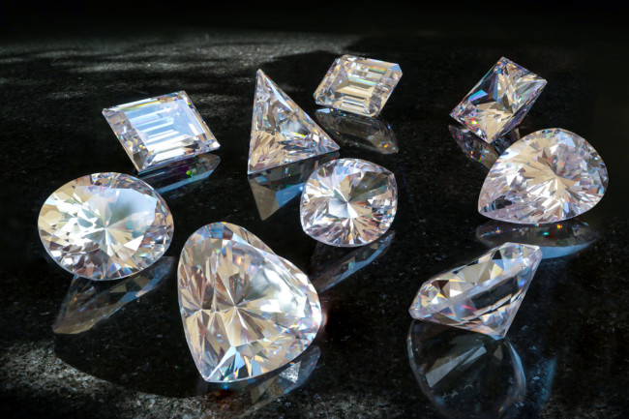
Qualities of a leader:
Influence
Communication
Honesty
Learning Agility

Slide 4


Influence

Slide 5
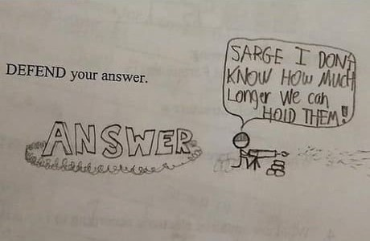
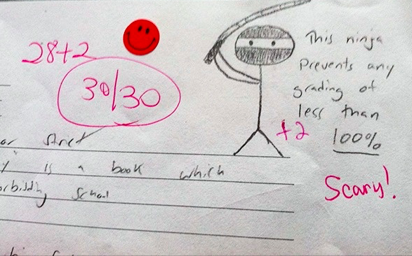
Communication and Negotiation skills

Slide 6
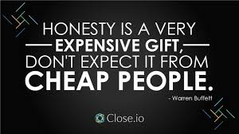
Honesty

Slide 7


Decision Making
What will you choose?
OR
Candy Bar
Lollipop

Slide 8
Conclusion
“If your actions inspire others to dream more, learn more, do more and become more, you are a leader.”

Slide 9
Thank You!

